Slide 1

Heart attack Detection device
Interactive System Engineering
By Jasmeet Singh Matta
06.15.2022

Slide 2
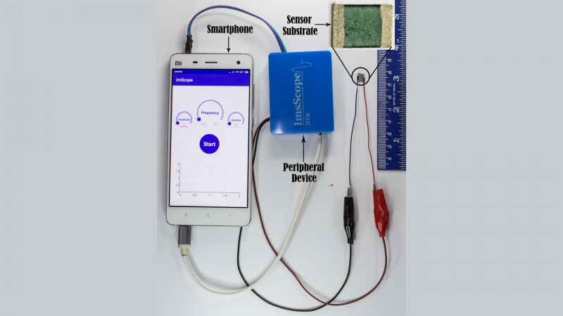
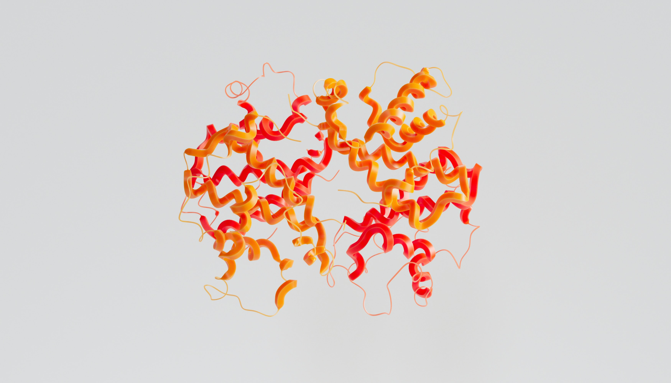
Concept Motivation
"Now, Your Smartphone Can Help You Detect A Heart Attack" IIT Bombay. 2018[Online] Availablehttps://www.iitb.ac.in/en/research-highlight/now-your-smartphone-can-help-you-detect-heart-attack
An estimated 17.9 million people died from CVDs in 2019, representing 32% of all global deaths. Of these deaths, 85% were due to heart attack and stroke
World Health Organization, “Cardiovascular Diseases (CVDs),” who.int, 2021. https://www.who.int/news-room/fact-sheets/detail/cardiovascular-diseases-(cvds)
‌

Slide 3
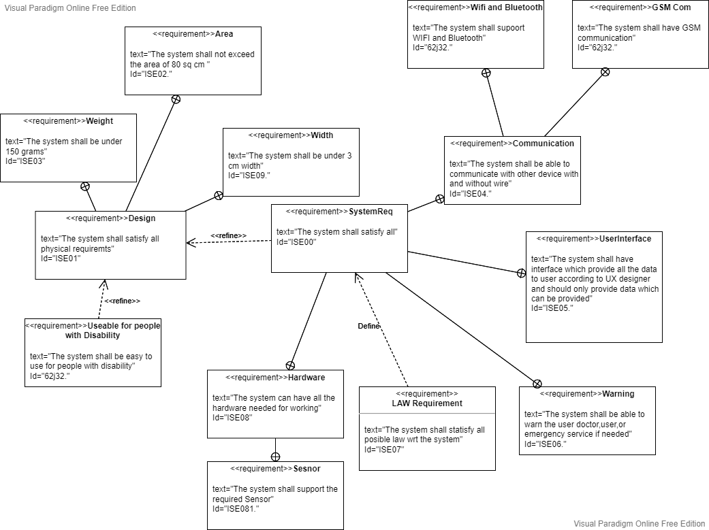
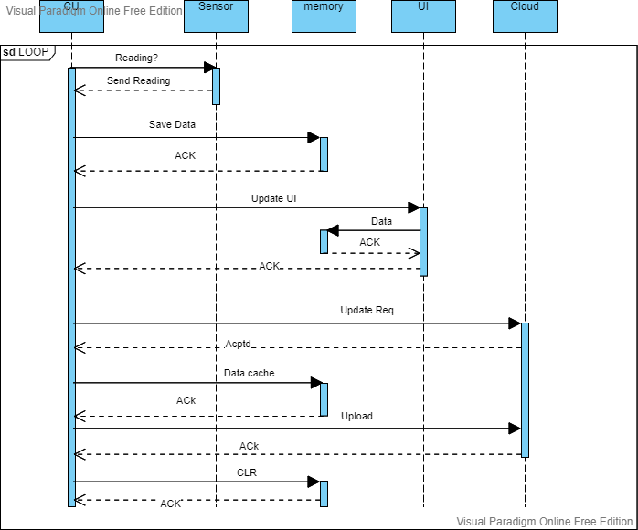
Requirement and modeling
What and why

Slide 4
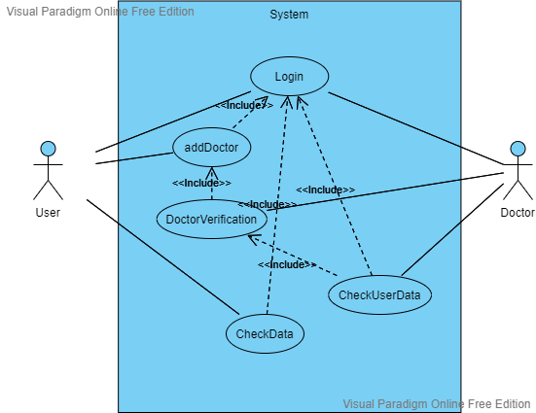
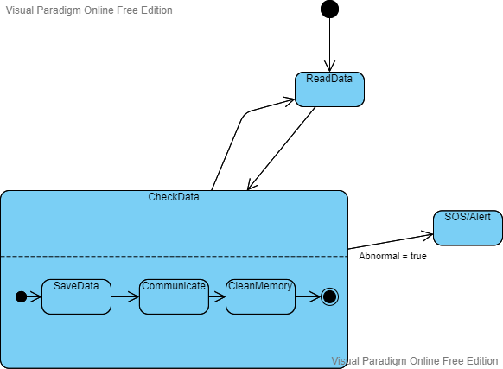

Slide 5
User Interface
Let’s Dive In

Slide 6


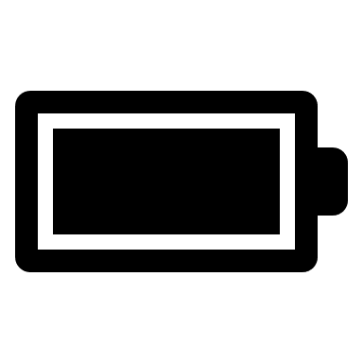
LOGO
Username
Password
Login
Login with Touch ID
Register

Slide 7
Heart Rate
118 bpm
Oxygen
94 %
Cardiac Biomarker
3 %
Status
Normal

Slide 8
Heart Rate
118 bpm
Oxygen
94 %
Cardiac Biomarker
3 %
Status
Consult Doctor

Slide 9
Heart Rate
118 bpm
Oxygen
94 %
Cardiac Biomarker
3 %
Status
Emergency

Slide 10

Graphs
Settings
Support

Slide 11


Slide 12
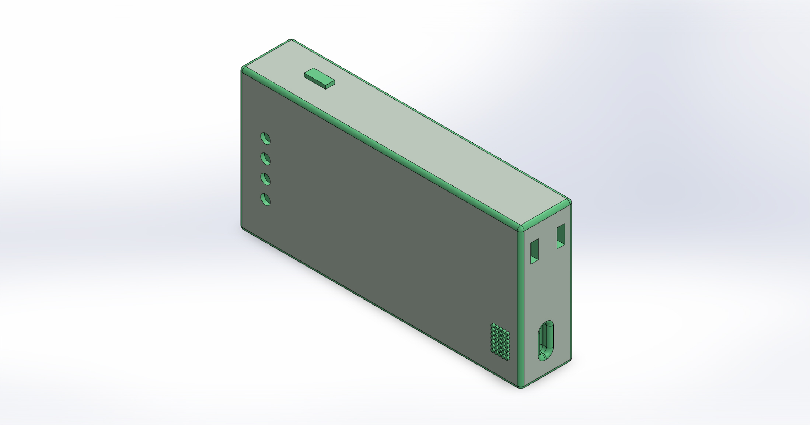

Slide 13
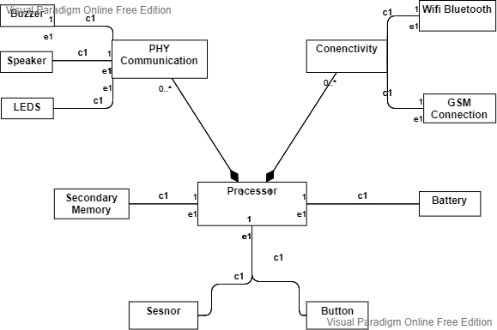
hardware
GSM - OPTIGA™ Connect Consumer OC1120
Wi-Fi Bluetooth WL1835MOD
66AK2G12 Processor by Texas Instruments

Slide 14

What’s next
LOOKING AHEAD

Slide 15

SUMMARY

Slide 16

THANK YOU
jasmeet-singh-ajit-singh.matta@stud.hshl.de
Jasmeet Singh Matta

